Slide 1
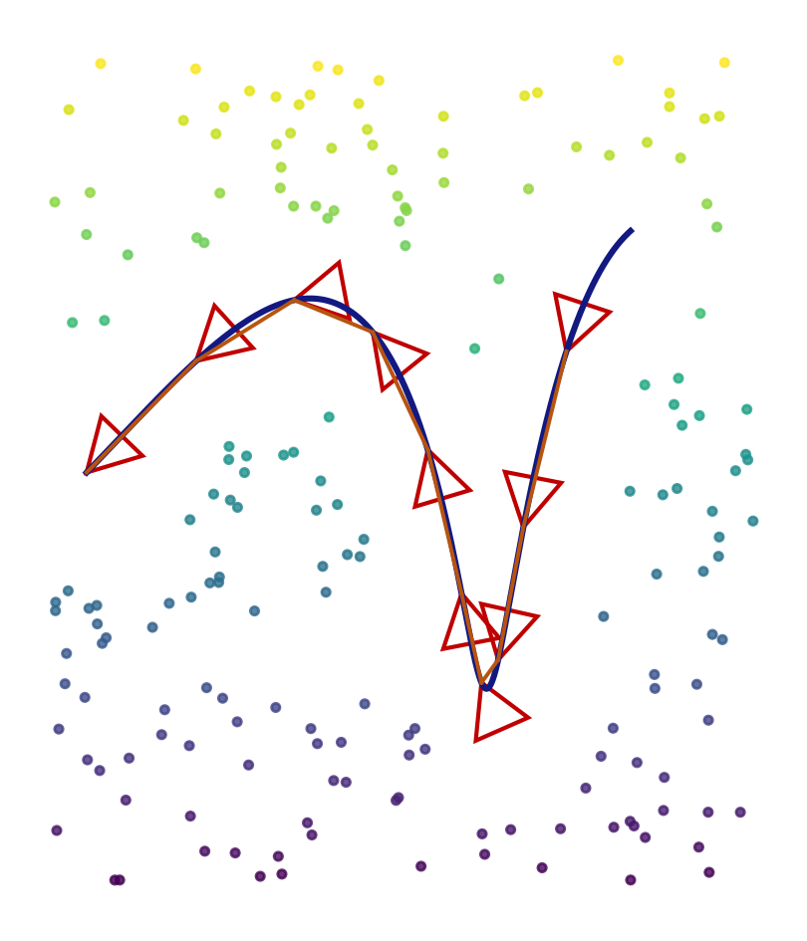
L9.2 Modern SLAM for AD
Zonghua Gu | Fall 2026

Slide 2
Roadmap and Learning Outcomes
Part 1
Part 2
Part 3
Part 4
Visual SLAM
Features, two-view geometry, PnP, bundle adjustment, ORB-SLAM3
Lecture A | ~45 min
LiDAR and LiDAR-Inertial SLAM
Scan matching, LOAM, LIO-SAM, degeneracy
Lecture A | ~30 min
Localization in AD Stacks
Prior maps, Autoware and Apollo, sensor fusion, error budget
Lecture B | ~30 min
Attacking Localization
GNSS and LiDAR spoofing, map and loop-closure attacks, defenses
Lecture B | ~30 min
After this lecture you should be able to:
1. Explain how a feature-based visual SLAM system tracks, maps, and corrects drift (PnP, bundle adjustment, loop closure)
2. Describe LiDAR odometry with edge and planar features, and why the IMU and the factor graph make it robust
3. Compare how Autoware and Apollo localize against a prior map and fuse GNSS, IMU, and LiDAR
4. Identify attack surfaces of localization and explain why slow GNSS drift and scan-matching spoofing are hard to detect

Slide 3
Recap: Front-End and Back-End
Front-end (sensor specific)
Back-end (sensor agnostic)
raw data → features, scan matches,
loop candidates → constraints (edges)
factor graph / pose graph
Gauss-Newton, iSAM2, robust losses
L9.1 built the back-end: EKF, particles, and pose graphs with Gauss-Newton
Today we look at the front-ends that real vehicles use: cameras and LiDAR, alone or with an IMU
Then we ask how a production AD stack localizes in a prior map, and what an attacker can do to it
Keep one question in mind: which constraint could be wrong, and who would notice?

Slide 4
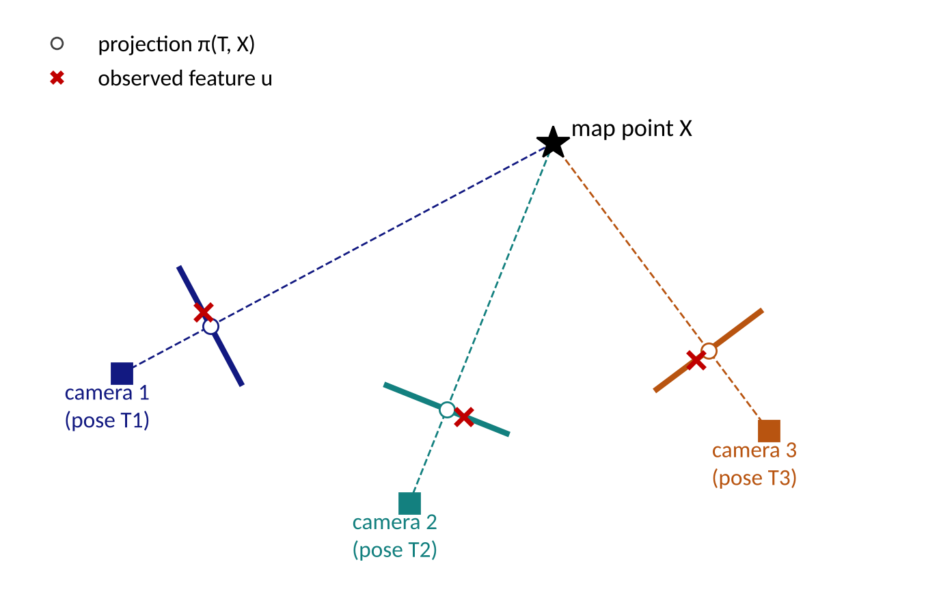
Part 1: Visual SLAM
cameras | features | geometry | bundle adjustment | ORB-SLAM3

Slide 5
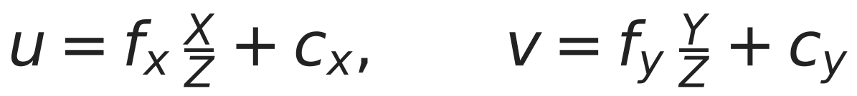
Cameras as SLAM Sensors
A camera measures bearing, not range: a pixel is the projection of a 3-D point along a ray
Pinhole model: a point (X, Y, Z) in the camera frame lands on pixel (u, v)
Cheap, dense, and rich in texture, but depth must be inferred from motion, a second camera, or other sensors
Needs texture and light: weak in dark, blurred, or textureless scenes
f = focal length in pixels, (cx, cy) = principal point; both come from calibration.
A world point is first moved into the camera frame with the camera pose T = (R, t), so each observation depends on the pose and the 3-D point: this is the measurement model h(x, m) of visual SLAM.

Slide 6
Feature-Based vs. Direct Methods
 | Feature-based (indirect) | Direct
Measures | keypoints and descriptors | pixel intensities
Error minimized | reprojection error (pixels) | photometric error (intensity)
Strengths | robust to lighting change; reliable loop closure and relocalization | uses all gradients; works in weak-texture areas
Weaknesses | needs distinct corners; discards most pixels | sensitive to exposure and rolling shutter; needs good initial guess
Examples | PTAM, ORB-SLAM family | LSD-SLAM, DSO
We follow the feature-based pipeline of ORB-SLAM, the most widely used open-source visual SLAM system.
Engel et al., LSD-SLAM, ECCV 2014 and DSO, T-PAMI 2018; Mur-Artal et al., ORB-SLAM, T-RO 2015.

Slide 7
From Pixels to Matches: ORB
Detect
Describe
Match
Verify
FAST corners on
an image pyramid
rotated BRIEF:
256-bit binary string
Hamming distance
+ ratio test
RANSAC with
geometric model
ORB = oriented FAST + rotated BRIEF: scale and rotation tolerant, and fast enough for real time on a CPU
Binary descriptors are compared with the Hamming distance (XOR + popcount): millions of comparisons per second
Ratio test: accept a match only if the best distance is clearly smaller than the second best (rejects repeated texture)
RANSAC removes the remaining outliers by fitting a geometric model (essential matrix or PnP): a few wrong matches can ruin pose estimation
Rublee et al., "ORB: an efficient alternative to SIFT or SURF", ICCV 2011.

Slide 8
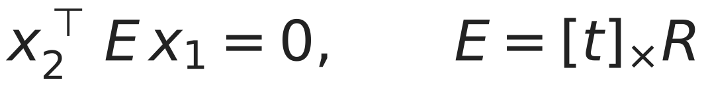
Two-View Geometry
A matched pair of normalized image points x1, x2 must satisfy the epipolar constraint:
From ≥ 5 matches (5-point algorithm, inside RANSAC) estimate E, then decompose it into the relative rotation R and the direction of translation t
Triangulation: intersect the two viewing rays to get the 3-D point; accuracy grows with the baseline (parallax) between the views
Failure cases: pure rotation (no parallax, no depth) and planar scenes (E is degenerate; a homography H explains the data)
ORB-SLAM initializes by computing both H and F/E in parallel and keeping the better-fitting model
Hartley and Zisserman, Multiple View Geometry; Nistér, "An efficient solution to the five-point relative pose problem", T-PAMI 2004.

Slide 9
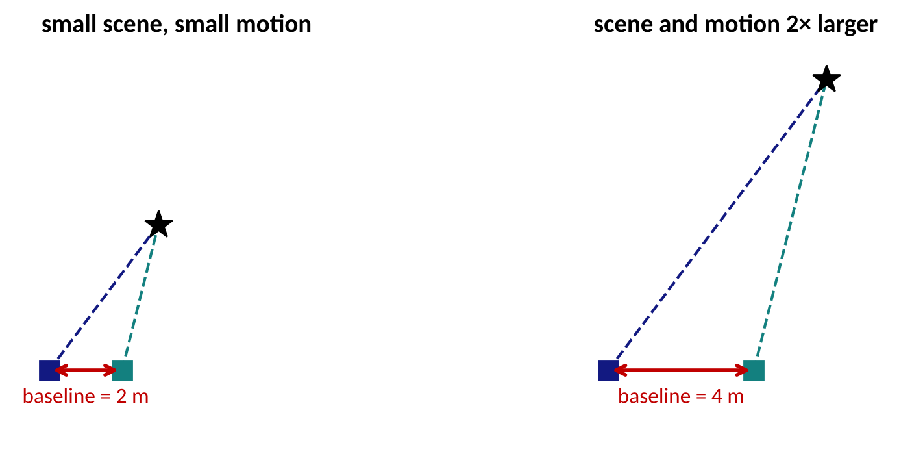
Monocular Scale Ambiguity
Scale the whole scene and the camera motion by s: every image stays identical, so one camera cannot recover metric scale
The map and trajectory are correct only up to a similarity transform (7 DoF); scale also drifts over time
Fixes: stereo (known baseline), IMU (gravity and acceleration), depth sensor or LiDAR, wheel odometry, or object sizes
For AD, metric scale is mandatory: a monocular-only map cannot tell 10 m from 20 m
Original figure: same viewing angles in both panels, baseline 2 m vs. 4 m.

Slide 10
Tracking with PnP
Given the previous pose, project the local map points into the new frame and match them to features nearby (guided search)
PnP (Perspective-n-Point): from n ≥ 3 known 3-D points and their pixels, solve the camera pose; use RANSAC around it
Then refine the pose with motion-only bundle adjustment: points fixed, only the 6-DoF pose is optimized
Decide whether the frame becomes a keyframe (enough new points, enough motion, tracking quality dropping)
If tracking is lost: relocalize with place recognition (bag of visual words) against all keyframes
Mur-Artal and Tardós, ORB-SLAM2, T-RO 2017; Lepetit et al., EPnP, IJCV 2009.

Slide 11
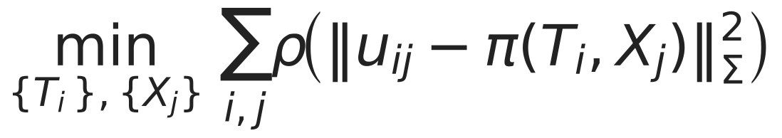
Bundle Adjustment
u = observed pixel, π(T, X) = projection of map point X into the camera with pose T, ρ = robust loss (Huber); the sum runs over all camera–point observations.
This is full SLAM from L9.1 with a camera measurement model: nodes are poses and points, edges are reprojection errors.
Solved with Gauss-Newton or Levenberg-Marquardt; the Schur complement eliminates the many points first, because each point touches only a few cameras
Local BA (recent keyframes) runs continuously; global BA runs after a loop closure
Triggs et al., "Bundle Adjustment: A Modern Synthesis", 1999. Figure: original schematic.

Slide 12
Keyframes and the Covisibility Graph
Processing every frame in the optimizer is too expensive: keep only keyframes that add information
Covisibility graph: keyframes are nodes; an edge links two keyframes that see many of the same map points
Local mapping optimizes only the current keyframe and its covisible neighbors, so the cost stays bounded as the map grows
Culling: redundant keyframes and weak map points are deleted, which keeps the map compact
The essential graph (a sparse spanning subgraph) is used to spread the correction after a loop closure
Mur-Artal, Montiel, Tardós, ORB-SLAM, T-RO 2015.

Slide 13
ORB-SLAM3 Architecture
Tracking
Local Mapping
Loop and Map Merging
every frame
extract ORB features
PnP + motion-only BA
keyframe decision
each keyframe
triangulate new points
local visual(-inertial) BA
cull keyframes and points
place recognition (DBoW2)
geometric verification
loop correction, global BA
merge maps
real-time thread
keeps the local map consistent
removes drift
Atlas: a set of disconnected maps; a lost tracker starts a new map and merges it when places are recognized
Supports monocular, stereo, and RGB-D cameras, optionally with an IMU, with pinhole or fisheye lenses
Three threads run in parallel, so tracking stays real-time while mapping and loop closing work in the background
Campos et al., "ORB-SLAM3", IEEE T-RO 2021 (diagram redrawn, simplified).

Slide 14
How Accurate Is ORB-SLAM3?
Benchmark | Sensors | ATE RMSE (m)
EuRoC (drone, 11 sequences, avg.) | monocular | 0.041*
EuRoC | stereo | 0.084
EuRoC | monocular + IMU | 0.043
EuRoC | stereo + IMU | 0.035
TUM-VI room (hand-held, avg.) | stereo + IMU | 0.009
*The monocular average excludes a sequence where tracking failed; trajectories are aligned with a similarity transform first
Centimeter-level accuracy in small indoor scenes with good texture; on large outdoor driving data (e.g., KITTI) drift grows to meters or more
Reported results are best-case: lighting, motion blur, and dynamic objects in real traffic are much harder
Campos et al., ORB-SLAM3, T-RO 2021, Tables II and IV (values as reported by the authors).

Slide 15
Adding an IMU: Visual-Inertial SLAM
The IMU gives metric scale and gravity direction, and bridges short visual failures (blur, fast rotation)
The camera corrects the IMU bias drift; each sensor covers the other's weakness
IMU readings between keyframes are pre-integrated into one relative-motion factor (no need to re-integrate when poses change)
ORB-SLAM3 initializes scale with about 5 % error from a 2-second trajectory, and refines it to about 1 % after visual-inertial BA at 15 s
Needs accurate time sync and extrinsic calibration between camera and IMU
Forster et al., "On-Manifold Preintegration", T-RO 2017; Campos et al., ORB-SLAM3, T-RO 2021.

Slide 16
Why Visual SLAM Fails on the Road
Condition | What breaks | Common mitigation
Night, glare, tunnel exit | few or unstable features | HDR / auto-exposure, IMU, other sensors
Fast motion, blur, rolling shutter | matching fails | global shutter, IMU, higher frame rate
Textureless road or wall | too few features | direct methods, LiDAR
Moving cars and pedestrians | wrong static-world assumption | semantic masks, RANSAC, robust loss
Repeated structure | false loop closure | geometric verification, robust back-end
Straight, forward motion | low parallax: poor depth | stereo, LiDAR, wheel odometry
Summary of common failure modes; see Cadena et al., T-RO 2016, and Campos et al., 2021.

Slide 17
Learning-Based and Neural SLAM
Learned components inside a classical pipeline: SuperPoint/SuperGlue features, learned depth and uncertainty
DROID-SLAM (2021): a recurrent network repeatedly updates camera poses and per-pixel depth; a dense bundle-adjustment layer ties them together, with monocular, stereo, and RGB-D variants
NeRF / 3-D Gaussian splatting SLAM: the map is a neural or splat radiance field that is rendered and compared with the images
Strengths: robustness to blur and low texture, dense maps. Costs: GPU, memory, domain shift, weak guarantees
Today most production AD stacks still rely on geometric SLAM and localization with learning used for perception
Teed and Deng, "DROID-SLAM: Deep Visual SLAM for Monocular, Stereo, and RGB-D Cameras", NeurIPS 2021.

Slide 18
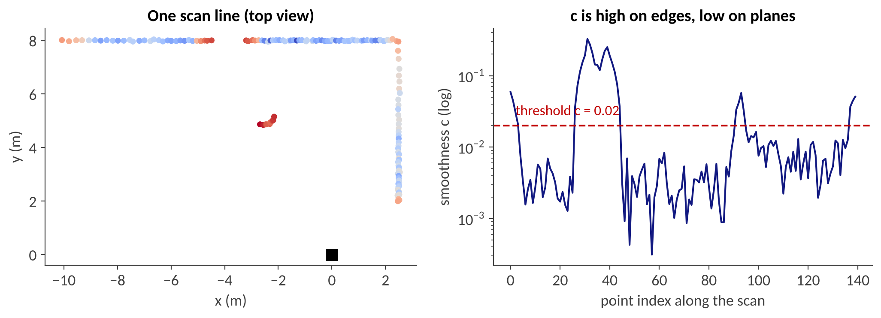
Part 2: LiDAR and LiDAR-Inertial SLAM
scan matching | LOAM | LIO-SAM | degeneracy | dynamic objects

Slide 19
Scan Registration: ICP and NDT
Find the rigid transform (R, t) that best aligns the current scan P to a reference Q (previous scan or map):
ICP: alternate (1) find nearest neighbors (data association) and (2) solve for the transform; converges only to a local minimum, so it needs a good initial guess
NDT: model the reference as a grid of Gaussians and maximize the likelihood of the scan; smooth cost, no point-to-point association; used in Autoware
The initial guess comes from the IMU or wheel odometry; this is why motion prediction and matching are always used together
The result is a relative-pose edge for the pose graph, with a covariance that the optimizer needs (often approximated)
Scan-to-scan matching drifts quickly; scan-to-map matching drifts much more slowly (but needs the map in memory)
Besl and McKay, ICP, T-PAMI 1992; Biber and Straßer, NDT, IROS 2003; Magnusson, PhD thesis 2009.

Slide 20
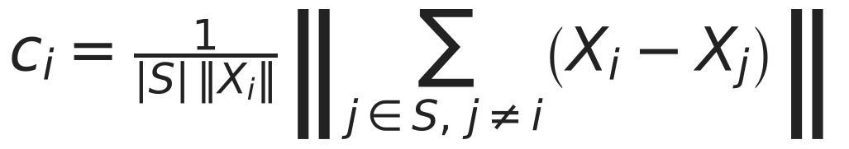
LOAM: Edge and Planar Features
S = the nearest points on the same scan line. Large c = edge, small c = plane.
Match edge points to lines and planar points to planes in the previous scan or map: the cost is a point-to-line or point-to-plane distance, so most of the cloud is never matched
In our toy scan with threshold c = 0.02, about 21 % of points are edge candidates; the rest are planar or discarded
Features are chosen per region of the scan so that matches are spread around the vehicle
Zhang and Singh, "LOAM: Lidar Odometry and Mapping in Real-time", RSS 2014. Figure: original toy scan with 2 cm noise.

Slide 21
LOAM: Fast Odometry, Slow Mapping
Lidar odometry (about 10 Hz)
Lidar mapping (about 10× slower)
scan k → scan k+1
match edge/planar features
fast, coarse, drifts
scan → accumulated map
more points, finer match
slow, accurate
pose
Splitting the problem into a high-frequency, low-fidelity and a low-frequency, high-fidelity estimator is what made real-time LiDAR SLAM practical on a CPU
During one sweep the sensor moves: points are deskewed using the motion estimate (otherwise the cloud is distorted)
LOAM has no loop closure and no IMU factor in its original form; later systems (LeGO-LOAM, LIO-SAM, FAST-LIO2) add them
LOAM ranked first on the KITTI odometry benchmark at the time of publication
Zhang and Singh, LOAM, RSS 2014 and Autonomous Robots 2017.

Slide 22
LIO-SAM: The Factor Graph
loop closure
IMU
IMU
IMU
IMU
x0
x1
x2
x3
x…
LiDAR
LiDAR
LiDAR
LiDAR
GNSS
Factors: IMU preintegration, LiDAR odometry (scan-to-local-map), optional GNSS, and loop closure; optimized incrementally with iSAM2
Scan matching uses a sliding window of recent keyframes, not the whole map, which keeps it fast and bounded
Shan et al., "LIO-SAM: Tightly-coupled Lidar Inertial Odometry via Smoothing and Mapping", IROS 2020. Diagram redrawn, simplified.

Slide 23
LIO-SAM: What the Factors Buy
End-to-end translation error (m) | LOAM | LIO-odom | LIO-GPS | LIO-SAM
Campus (1.4 km walk, GPS rarely available) | 192.43 | 9.44 | 6.87 | 0.12
Park (2.9 km, forest trail, UGV) | 121.74 | 36.36 | 2.93 | 0.04
The metric is the error when the robot returns to its start; LIO-odom = IMU + LiDAR factors only, LIO-GPS adds GNSS, LIO-SAM adds loop closure
Each added factor reduces drift; the loop closure gives the largest jump, which is why false loops are so dangerous (L9.1)
Keyframe rule: new keyframe after 1 m or 10°; loop candidates within 15 m of the current state
Reported for handheld and small-robot data: car-scale speeds, tunnels, and traffic are harder
Shan et al., LIO-SAM, IROS 2020, Table II (values as reported by the authors; one run per dataset).

Slide 24
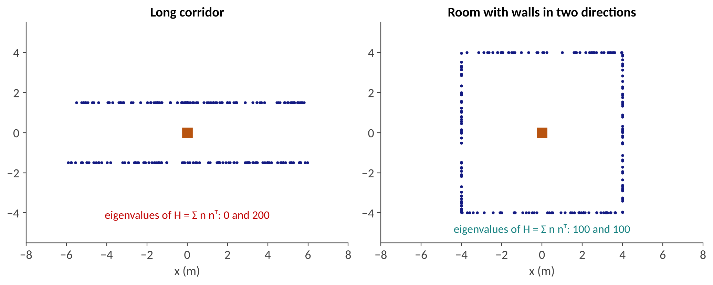
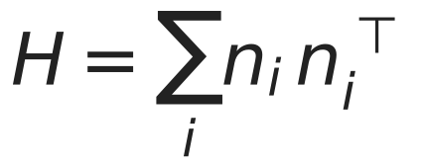
Degeneracy in Scan Matching
Each matched plane constrains the translation only along its normal; H collects all constraints
A long corridor has all normals in one direction: eigenvalue 0 along the corridor, so the scan matcher cannot tell how far the car moved
Tunnels, highways with guardrails, and open fields behave the same way; fix: IMU, wheel odometry, GNSS, or degeneracy-aware solvers
Original toy example: 200 points, unit normals; see Zhang et al., "On Degeneracy of Optimization-based State Estimation Problems", ICRA 2016.

Slide 25
Dynamic Objects, Maps, and Drift
Parked or moving vehicles and pedestrians violate the static-world assumption: they create ghost points and wrong matches
Remedies: segment and remove movable classes (semantic or learned), consistency checks across scans, and removal of moving points when building the map
Long-term change: construction, seasons, new buildings; a map older than a few months may no longer match
Drift per distance is small for LiDAR (typically a fraction of a percent of distance) but never zero: loop closure or GNSS is needed
Compute: a 64-beam LiDAR yields ~10⁵ points per scan; voxel downsampling and feature selection are essential
Cadena et al., T-RO 2016; Pomerleau et al., "A Review of Point Cloud Registration Algorithms for Mobile Robotics", 2015.

Slide 26
Visual vs. LiDAR vs. Fusion
 | Camera (visual SLAM) | LiDAR (LiDAR SLAM) | Camera + LiDAR + IMU
Metric scale | needs stereo or IMU | direct | direct
Texture / lighting | sensitive | works at night | complementary
Geometry | sparse, triangulated | dense, accurate range | best of both
Weak spots | dark, blur, textureless | corridors, rain/fog, sparse scenes | calibration, sync, cost
Loop closure | bag of words, cheap | scan descriptors, more compute | either, cross-checked
Cost / power | low | high (sensor) | highest
Summary; examples of fusion: LVI-SAM (Shan et al., IROS 2021), FAST-LIVO.

Slide 27
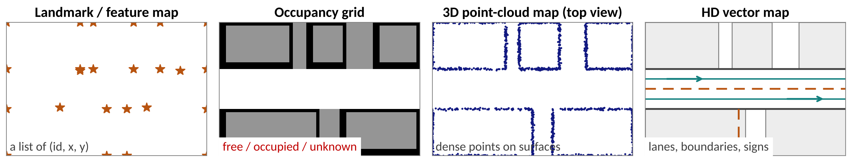
Part 3: Localization in AD Stacks
prior maps | map matching | Autoware and Apollo | fusion | error budget

Slide 28
From Mapping to Localization
Offline (before deployment)
Survey drive
SLAM + BA
Clean map
Map product
LiDAR, camera,
IMU, RTK GNSS
graph optimization,
loop closure
remove dynamic
objects
point-cloud map,
lane-level HD map
Online (every drive)
Predict
Match
Fuse
Pose + covariance
IMU + wheel
odometry
live scan ↔ map
(NDT, ICP)
GNSS/RTK,
error-state KF
to planning, at
≥ 10 Hz
SLAM builds the map once, with the best sensors and offline optimization; production vehicles then only localize in it.

Slide 29
Map-Based Localization
The prior map turns SLAM into localization: drift is no longer integrated, because each scan is anchored to a fixed reference
Point-cloud maps: match the live scan with NDT or ICP; centimeter-level, but maps are large (gigabytes per city)
Reflectivity or height maps (grid of intensity and altitude): smaller, easier to match, used by Baidu Apollo
HD vector maps (lanes, signs, poles): lightweight; localize by matching detected lane markings and landmarks
Output: pose in the map frame plus a covariance, which downstream planning uses to decide how much margin to keep
Wan et al., "Robust and Precise Vehicle Localization based on Multi-sensor Fusion in Diverse City Scenes", ICRA 2018; Autoware documentation.

Slide 30
Case Study: Autoware vs. Apollo
 | Autoware (open source) | Baidu Apollo (open source)
Map used | 3-D point-cloud map (PCD) + Lanelet2 | LiDAR reflectance/height map + HD map
LiDAR matching | NDT scan matcher | LiDAR matching against the map grid
Fusion filter | EKF (pose from NDT, twist from odometry) | error-state Kalman filter with IMU
GNSS role | initial pose, optional measurement | RTK GNSS as a measurement
Outputs | pose + covariance, with a convergence score | pose + covariance (MSF localization)
Both follow the same recipe: IMU propagation + map matching + GNSS correction in a Kalman filter. Module names change between releases; check the current documentation.
Autoware documentation (ndt_scan_matcher, ekf_localizer); Apollo localization module documentation; Wan et al., ICRA 2018.

Slide 31
Fusion Architecture
IMU + wheel odometry
Error-state Kalman filter
predict at IMU rate (100+ Hz)
update at LiDAR rate (10 Hz)
update at GNSS rate (1–10 Hz)
innovation gate on each update
Pose + covariance
to planning
LiDAR ↔ map matching
GNSS / RTK
Error-state (indirect) filter: estimate the small error of a nominal IMU-integrated state, which keeps the linearization accurate
The innovation gate (Mahalanobis test from L9.1) rejects measurements that disagree with the prediction
This is also where an attacker aims: whatever passes the gate moves the pose
Sola, "Quaternion kinematics for the error-state Kalman filter", 2017; Wan et al., ICRA 2018. Diagram: simplified, original.

Slide 32
How Accurate Must Localization Be?
Lateral margin in a lane: a 3.7 m lane and a 1.9 m wide car leave a one-sided clearance of
This is the absolute upper bound before the car touches the lane line; planning also needs margin for control error and perception error
Lane-level driving therefore targets decimeter-level or better lateral error; many stacks aim for centimeters
Latency is part of the budget: at 20 m/s a 0.1 s delay equals 2 m of travel (the same arithmetic as the L4.3 latency budget)
The reported covariance matters as much as the pose: an over-confident filter hides errors from the planner
Safety cases (ISO 26262 / SOTIF) require that localization failures are detected and a safe fallback exists
Standard US lane width 3.7 m; vehicle width 1.9 m is a typical passenger car. Numbers are illustrative.

Slide 33
When Map-Based Localization Fails
Map changed: construction, new buildings, seasonal vegetation; the match score drops or, worse, converges to a wrong local optimum
Degenerate geometry: tunnels, long highway walls, open fields; the filter relies on IMU and odometry and drifts
GNSS degraded: multipath in urban canyons produces plausible but wrong positions (not a clean outage)
Kidnapped robot: after a reboot or tunnel, the filter must re-initialize globally, not locally
Mapless / lightweight maps: HD maps are costly to build and keep fresh; some stacks use SLAM-style online mapping or navigation maps with a smaller prior
Discussion: for a 500 m tunnel at 25 m/s, what accumulates, and for how long?
Discussion answer: 20 s without GNSS; drift is set by IMU bias and odometry scale error (see exercise deck).

Slide 34
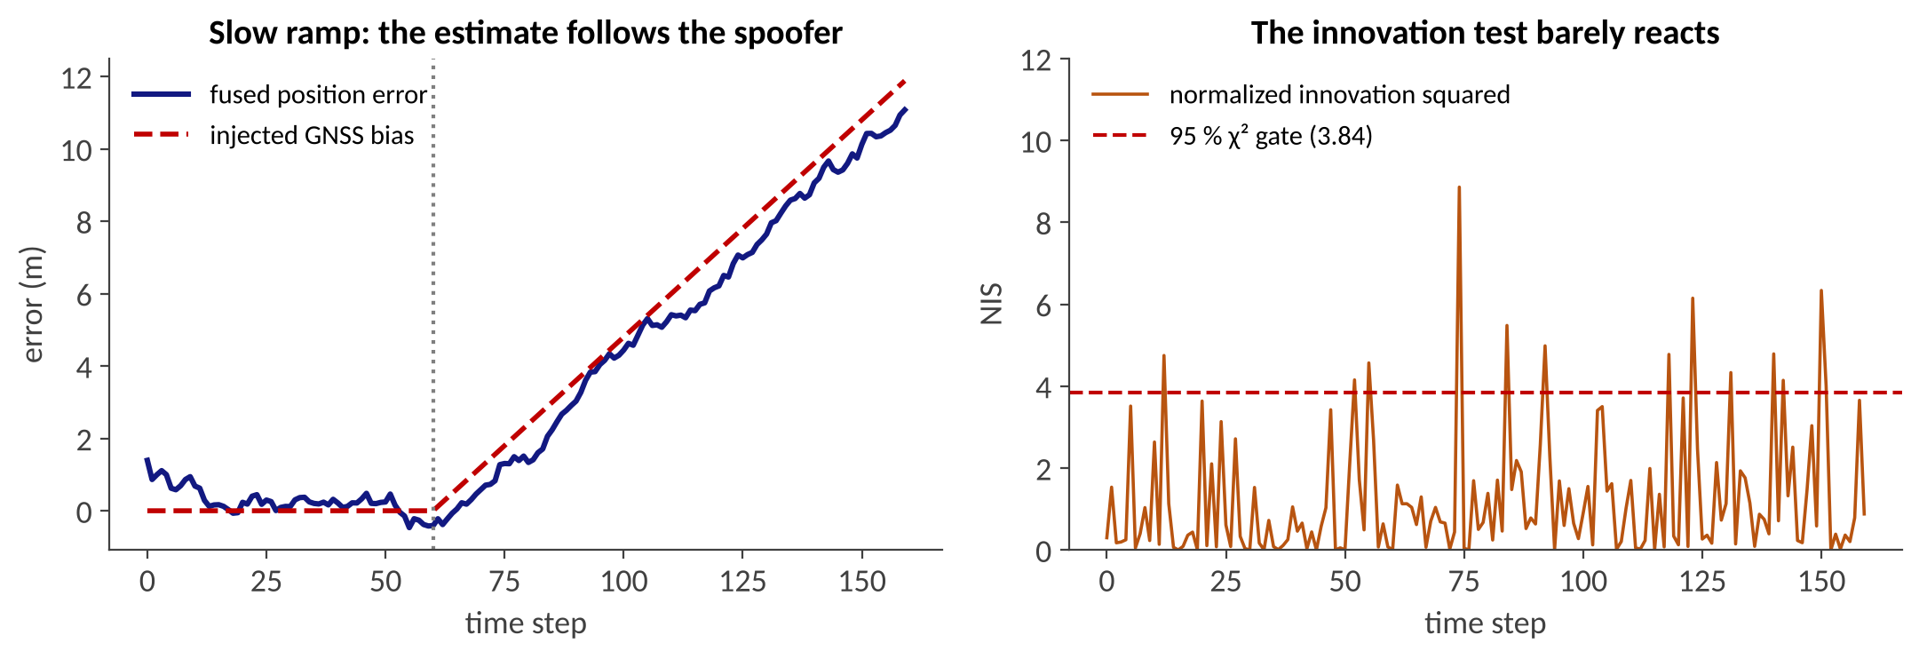
Part 4: Attacking Localization
attack surface | GNSS and LiDAR spoofing | slow drift | map attacks | defenses

Slide 35
The Localization Attack Surface
GNSS
LiDAR
Camera
spoofing, jamming
laser injection, object placement
blinding, adversarial patterns
IMU / odometry
Map
Back-end
acoustic or wheel-slip faults
tampering, outdated data
false loops, gate manipulation
Attacks can be physical (RF, lasers, objects), data (map, update channel), or algorithmic (exploit the estimator)
Goal of the attacker: not a crash of the software, but a small, consistent pose error that steers the car out of its lane
A fusion system is only as strong as its weakest input that the filter still trusts

Slide 36
GNSS Spoofing and Sensor Fusion
Spoofing transmits fake satellite signals, so the receiver reports an attacker-chosen position; in 2018 Zeng et al. showed stealthy manipulation of navigation routes with a portable spoofer
Multi-sensor fusion was expected to resist it, because IMU and LiDAR disagree with a fake position
FusionRipper (Shen et al., USENIX Security 2020): spoof GNSS in a way that exploits how a production MSF filter weighs its inputs, so the fused pose drifts away from the truth
Reported success: at least 97 % (drive off the road) and 91.3 % (drive into the wrong way) across six real-world sensor traces
Message: fusing sensors is necessary but not sufficient: the fusion logic itself is an attack target
Zeng et al., "All Your GPS Are Belong To Us", USENIX Security 2018; Shen et al., "Drift with Devil", USENIX Security 2020.

Slide 37
Slow Drift vs. the Innovation Gate
Toy 1-D filter (IMU + GNSS, σ = 1 m): after t = 60 the spoofer adds 0.12 m per step to GNSS; the fused error reaches 11 m by the end
Gate exceedance rate: 5 % before the attack vs. 10 % during it; the gate sees almost nothing (a 95 % gate flags 5 % by design)
Reason: each step's disagreement is within noise; the filter absorbs it, so the innovation test cannot tell bias from noise. Needs a drift-aware check (e.g., compare against LiDAR or odometry over a window)
Original simulation (seed 6). Scalar KF, 160 steps, 95 % χ² gate = 3.84 for 1 DoF. Illustrative, not a model of a real stack.

Slide 38
LiDAR Spoofing: SLAMSpoof
Attackers can inject laser pulses into a LiDAR so that the points the vehicle receives are different from the real scene
Earlier attacks focused on perception (fake obstacles); SLAMSpoof targets localization by making scan matching converge to a wrong pose
The attack uses a scan-matching vulnerability score to choose where to place spoofed points that have the most influence
In real-world tests on ground vehicles it induced position errors of 4.2 m or more against three popular LiDAR-based localization algorithms, more than a lane width
The authors also discuss countermeasures; this is a young research area
Nagata et al., "SLAMSpoof: Practical LiDAR Spoofing Attacks on Localization Systems Guided by Scan Matching Vulnerability Analysis", 2025 (arXiv:2502.13641).

Slide 39
Why Scan Matching Is Vulnerable
The Hessian H = Σ n nᵀ shows which directions the scan pins down.
Room: eigenvalues 100 and 100.
If the two walls facing x are missing or replaced: 0 and 100, so x is no longer constrained.
Scan matching trusts the points: an attacker who controls a subset of points that carry most of the constraint controls the result
Attack-aware reasoning: find the points whose removal or shift changes the optimum the most (high sensitivity = high vulnerability)
The same math explains accidental failures (corridors) and deliberate ones (spoofing): both shrink the information in H
Defense idea: monitor the eigenvalues and match residuals, and check consistency with IMU, odometry, and other sensors
Toy numbers from the L9.2 degeneracy example (50 points per wall); SLAMSpoof uses a more detailed, point-wise vulnerability score.

Slide 40
Attacks on Loops, Maps, Timing
False loop closure: a spoofed or look-alike place makes the back-end add a wrong edge; in our L9.1 demo one false edge raised ATE from 0.6 m to 12.3 m
Map poisoning: if map updates, crowd-sourced maps, or OTA channels are not authenticated, the attacker changes the reference everyone localizes against
Timing: delayed or replayed sensor data shifts the pose by speed × delay (20 m/s × 0.1 s = 2 m); time sync and authenticated timestamps matter
Estimator exploits: manipulate noise covariances, gate thresholds, or sensor trust (e.g., drive the filter to rely on the spoofed source)
In all cases the pose is wrong but plausible: nothing crashes, which is why these attacks are dangerous
Pose graph demo: L9.1 slide 39 (original simulation).

Slide 41
Defenses
Defense | Idea | Limit
Redundancy and cross-checks | compare GNSS, LiDAR, camera, IMU, odometry | fusion logic can be exploited
Innovation / residual monitoring | chi-square tests on each update | misses slow drift (slide 37)
Windowed drift detection | compare sensors over seconds, not steps | adds delay; threshold tuning
Robust back-end | robust loss, switchable constraints, loop verification | needs good initial guess
Authenticated signals | GNSS authentication (e.g., Galileo OSNMA), signed map updates | deployment and coverage
Physical-layer hardening | LiDAR pulse coding, randomized timing, filtering | cost; attackers adapt
Safe fallback | degrade speed, request takeover, stop safely | needs a trusted detection
Synthesis of the defenses discussed in Shen et al., 2020; Nagata et al., 2025; and Cadena et al., 2016.

Slide 42
In-Class Activity and Lab Ideas
Run it (30 min): run ORB-SLAM3 or a LiDAR SLAM package (e.g., LIO-SAM, FAST-LIO2) on a public sequence (EuRoC, KITTI); compute ATE with evo
Compute it (10 min): lateral error budget and latency distance with your own numbers (see the exercise deck)
Simulate an attack (30 min): extend the 1-D filter on slide 37: change the ramp rate and the gate; find the fastest ramp that is still undetected
Discussion: if you were designing the safety monitor for a localization stack, which two signals would you cross-check, and why?

Slide 43
Summary and Further Resources
Key takeaways
Further resources
Visual SLAM: features, PnP, bundle adjustment; monocular scale is unknown without an IMU or stereo
LiDAR SLAM: edge and planar features, dual-rate LOAM; LIO-SAM adds IMU, GNSS, and loop-closure factors
Degeneracy (H has a zero eigenvalue) is the common weakness of scan matching
AD stacks localize in a prior map: IMU + map matching + GNSS in a Kalman filter; σ ≲ 0.3 m
Localization is a security-critical component: small, plausible errors are the real threat
Campos et al.: ORB-SLAM3 (T-RO 2021)
Zhang and Singh: LOAM; Shan et al.: LIO-SAM
Barfoot: State Estimation for Robotics (free online)
Shen et al.: Drift with Devil (USENIX Security 2020)
Open source: ORB-SLAM3, LIO-SAM, FAST-LIO2, Autoware, Apollo
Links are listed on the next slide.

Slide 44
References
[1] C. Campos et al., "ORB-SLAM3: An Accurate Open-Source Library for Visual, Visual-Inertial and Multi-Map SLAM", IEEE T-RO, 2021. arxiv.org/abs/2007.11898
[2] R. Mur-Artal, J. M. M. Montiel, J. D. Tardós, "ORB-SLAM: A Versatile and Accurate Monocular SLAM System", IEEE T-RO, 2015.
[3] E. Rublee et al., "ORB: An efficient alternative to SIFT or SURF", ICCV 2011.
[4] R. Hartley, A. Zisserman, Multiple View Geometry in Computer Vision, Cambridge Univ. Press; B. Triggs et al., "Bundle Adjustment: A Modern Synthesis", 1999.
[5] J. Zhang, S. Singh, "LOAM: Lidar Odometry and Mapping in Real-time", RSS 2014.
[6] T. Shan, B. Englot, et al., "LIO-SAM: Tightly-coupled Lidar Inertial Odometry via Smoothing and Mapping", IROS 2020. arxiv.org/abs/2007.00258
[7] Z. Teed, J. Deng, "DROID-SLAM: Deep Visual SLAM for Monocular, Stereo, and RGB-D Cameras", NeurIPS 2021. arxiv.org/abs/2108.10869
[8] G. Wan et al., "Robust and Precise Vehicle Localization based on Multi-sensor Fusion in Diverse City Scenes", ICRA 2018 (Baidu Apollo).
[9] K. Zeng et al., "All Your GPS Are Belong To Us: Towards Stealthy Manipulation of Road Navigation Systems", USENIX Security 2018.
[10] J. Shen et al., "Drift with Devil: Security of Multi-Sensor Fusion based Localization in High-Level Autonomous Driving under GPS Spoofing", USENIX Security 2020. arxiv.org/abs/2006.10318
[11] R. Nagata et al., "SLAMSpoof: Practical LiDAR Spoofing Attacks on Localization Systems Guided by Scan Matching Vulnerability Analysis", 2025. arxiv.org/abs/2502.13641
[12] Autoware and Apollo documentation (localization modules). Figures: original simulations and schematics created for this lecture.

